Slide 1

Healthcare cost Analysis
Data Science with R programming

Slide 2
Description

Slide 3
Background and Objective:
A nationwide survey of hospital costs conducted by the US Agency for Healthcare consists of hospital records of inpatient samples. The given data is restricted to the city of Wisconsin and relates to patients in the age group 0-17 years. The agency wants to analyse the data to research on healthcare costs and their utilization.
Domain: Healthcare
Dataset Description:
Here is a detailed description of the given dataset:
Attribute | Description
Age | Age of the patient discharged
Female | A binary variable that indicates if the patient is female
Los | Length of stay in days
Race | Race of the patient (specified numerically)
Totchg | Hospital discharge costs
Aprdrg | All Patient Refined Diagnosis Related Groups

Slide 4
Analysis to be done:
1. To record the patient statistics, the agency wants to find the age category of people who frequently visit the hospital and has the maximum expenditure.
2. In order of severity of the diagnosis and treatments and to find out the expensive treatments, the agency wants to find the diagnosis-related group that has maximum hospitalization and expenditure.
3. To make sure that there is no malpractice, the agency needs to analyse if the race of the patient is related to the hospitalization costs.
4. To properly utilize the costs, the agency has to analyse the severity of the hospital costs by age and gender for the proper allocation of resources.
5. Since the length of stay is the crucial factor for inpatients, the agency wants to find if the length of stay can be predicted from age, gender, and race.
6. To perform a complete analysis, the agency wants to find the variable that mainly affects hospital costs.
Download the dataset from here : Download dataset

Slide 5
Analysis

Slide 6
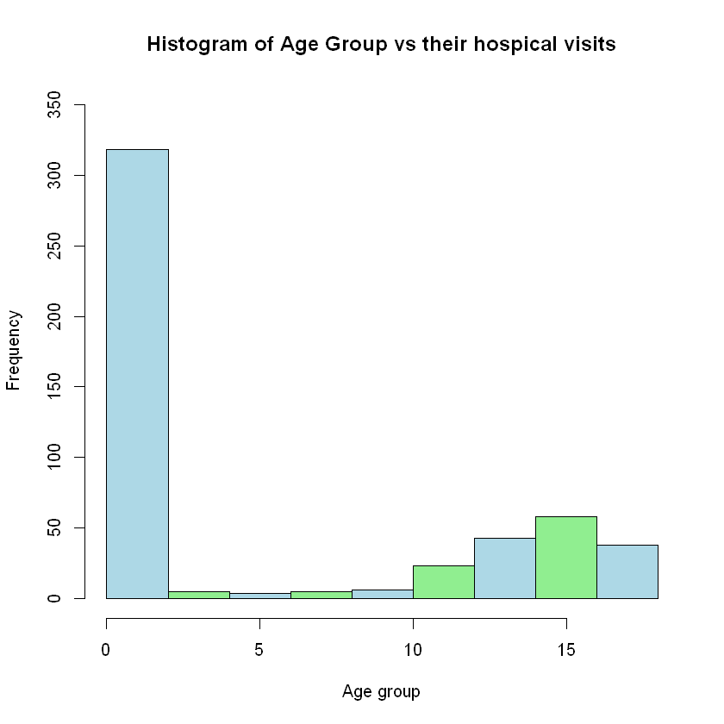
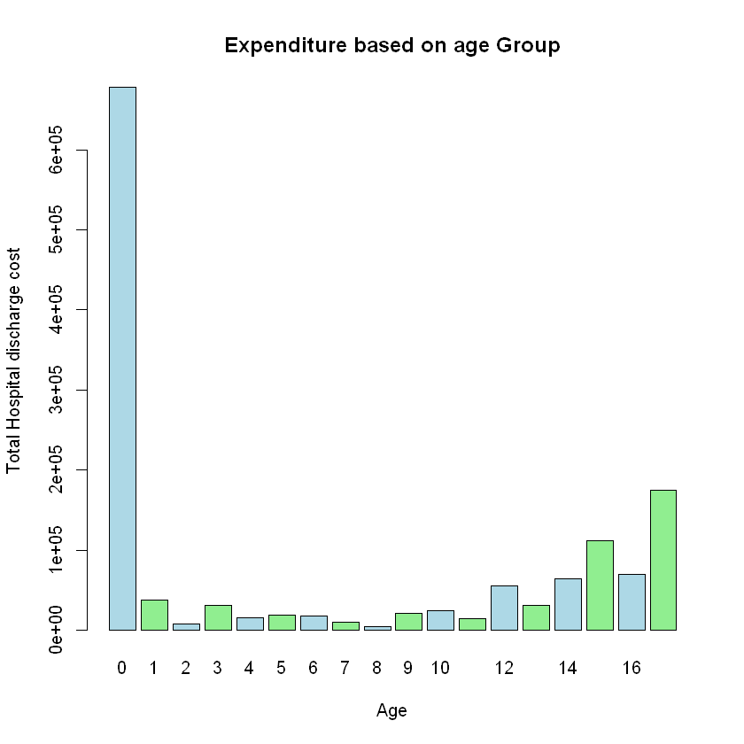
1. Recorded patient statistics
Maximum number of patients are from 0-1 age group, total count is 307.
Maximum expenditure for group 0-1 years is 678118

Slide 7
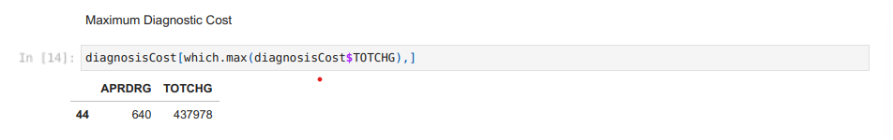
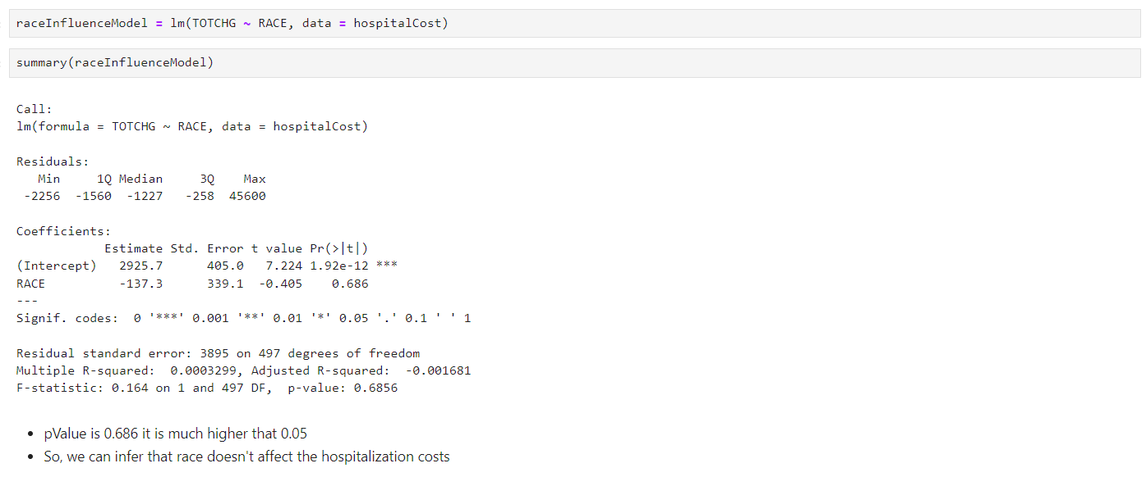
2. Diagnosis-related group that has maximum hospitalization and expenditure
3. Race vs Hospitalization Costs

Slide 8
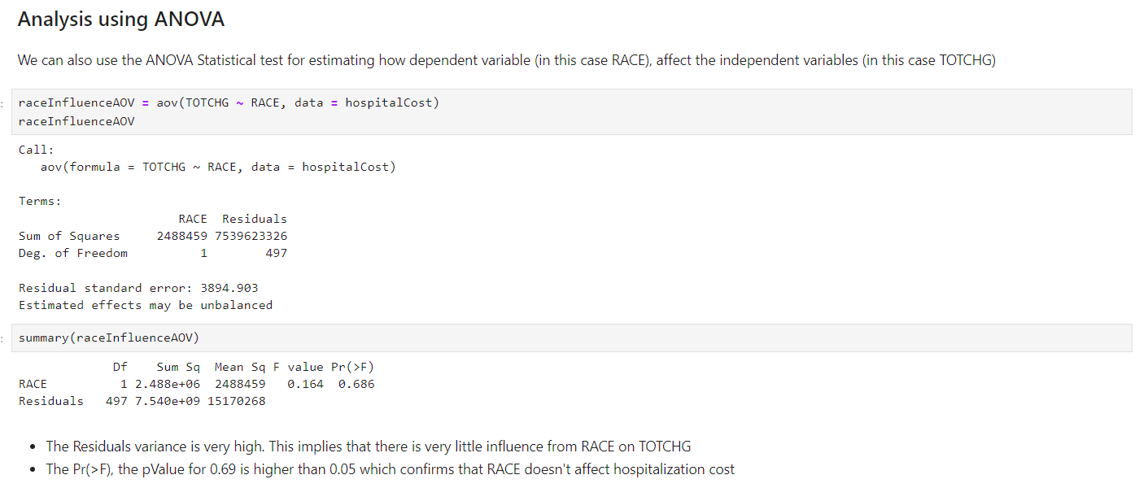

Slide 9
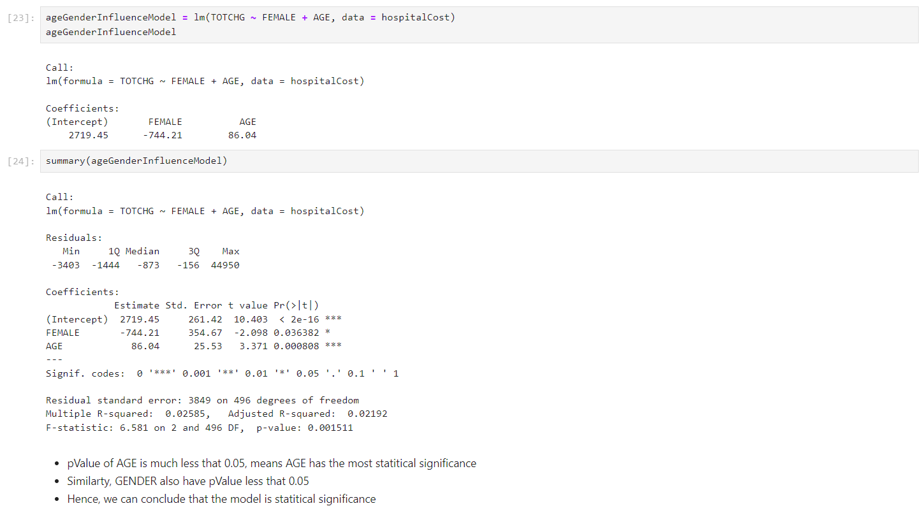
4. Age and Gender vs Hospitalization costs

Slide 10
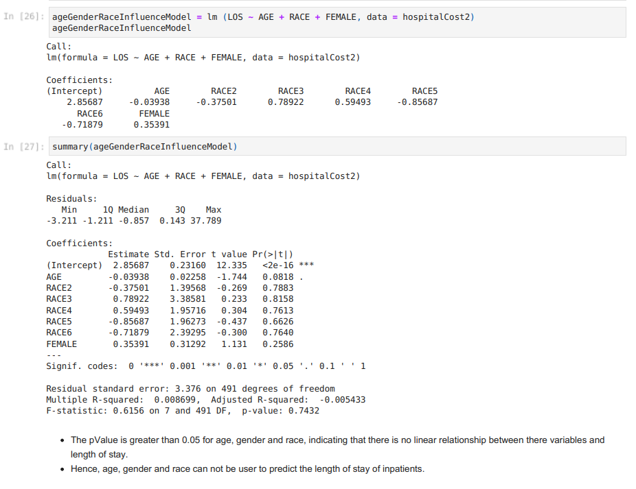
5. Can length of stay be predicted from age, gender, and race

Slide 11
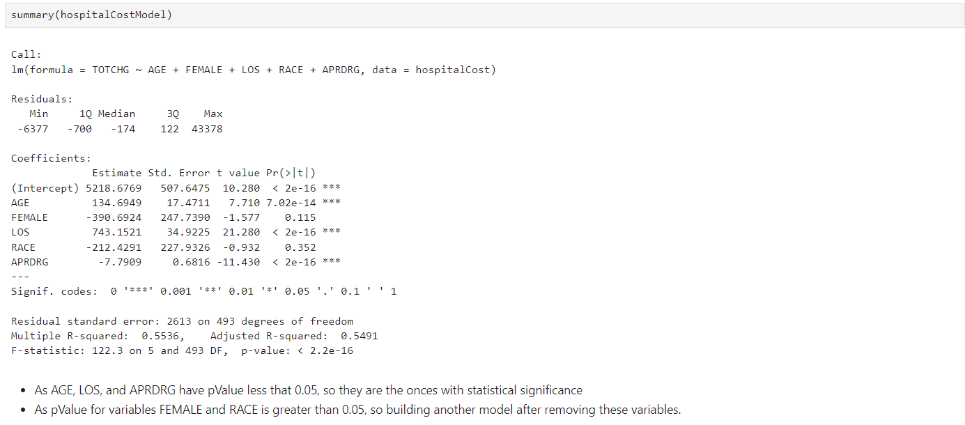
6. Complete Analysis

Slide 12
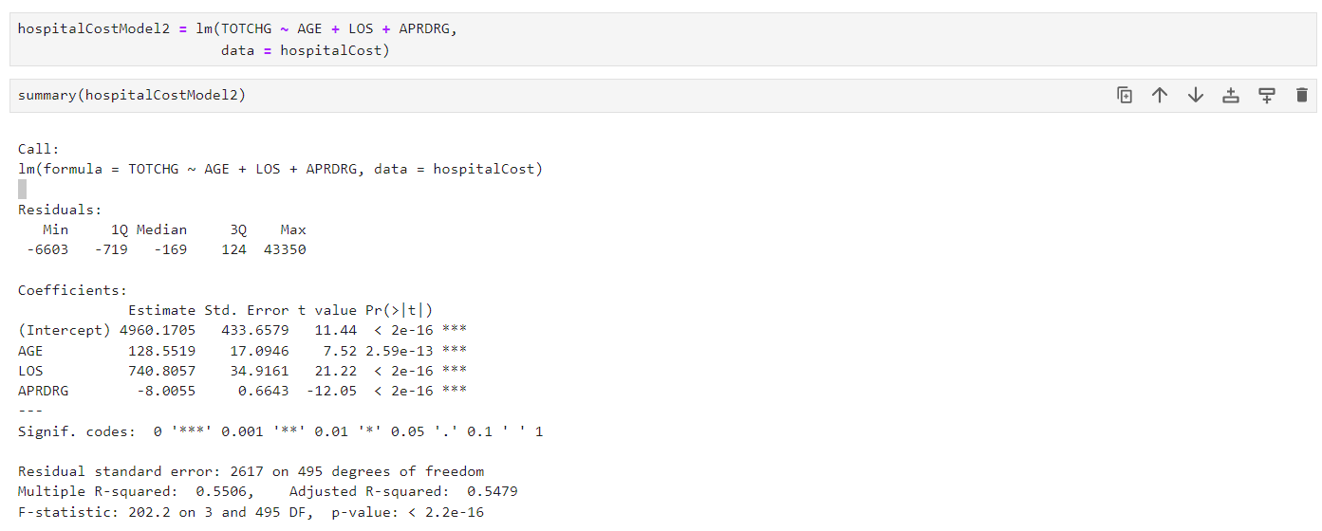

Slide 13
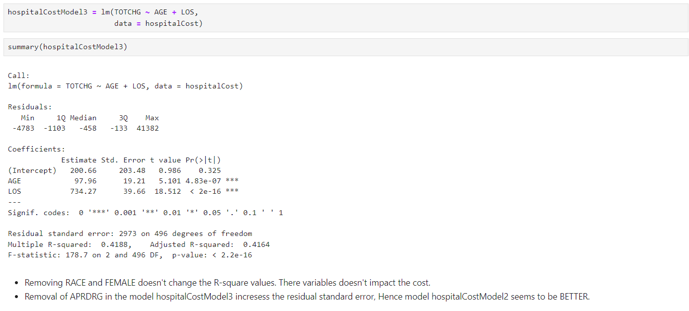

Slide 14
Thank you

